Slide 1
Flight fare price prediction
YASH KESHARI
Md Ehsanul Haque Kanan

Slide 2
CONTENTS
Objective
Benefits
Data Description.
Architecture
Workflow
Q&A

Slide 3
Objective
The primary objective of the Flight Fare Price Prediction project is to guide traveler with accurate and personalized fare predictions. By allowing users to input key travel details such as departure and arrival locations, travel dates, preferred airlines, the number of stops, and desired travel duration, the system aims to provide fare estimates tailored to individual preferences. This project's goal is to simplify the flight booking process, assist users in making cost-effective choices, and enhance their overall travel planning experience.

Slide 4
Benefits
Personalized Travel Planning
Cost Efficiency
Time Saving
Enhanced User Experience
Data-Driven Decision Making
Convenience
Flexible Options
Improved Travel Planning
Enhanced Booking Confidence
Time and Stress Reduction

Slide 5
User input fields
- The system collects user input for Arrival, Departure, Date, Airline, Number of Stops, and Duration.
Arrival:
Users specify their desired destination, indicating where they want to travel to.
Departure:
Travelers input their starting point or departure city/airport for the journey.
Date:
Users provide the travel dates, specifying when they plan to depart and return.
Airline:
Travelers have the option to select their preferred airline for the journey.
Number of Stops:
Users indicate their preference for non-stop flights or specify the number of stops they are willing to accept.
Duration:
Travelers specify the desired travel duration or flight time, helping the system recommend flights that align with their time preferences.

Slide 6
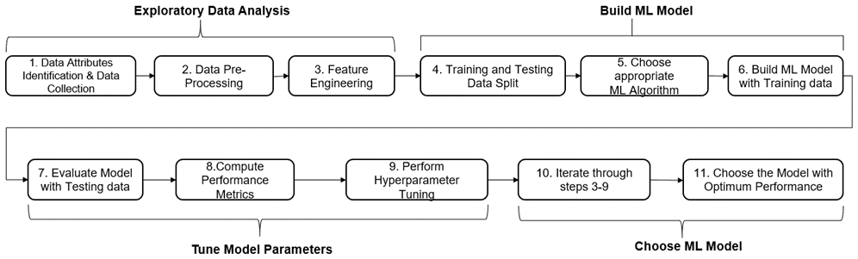
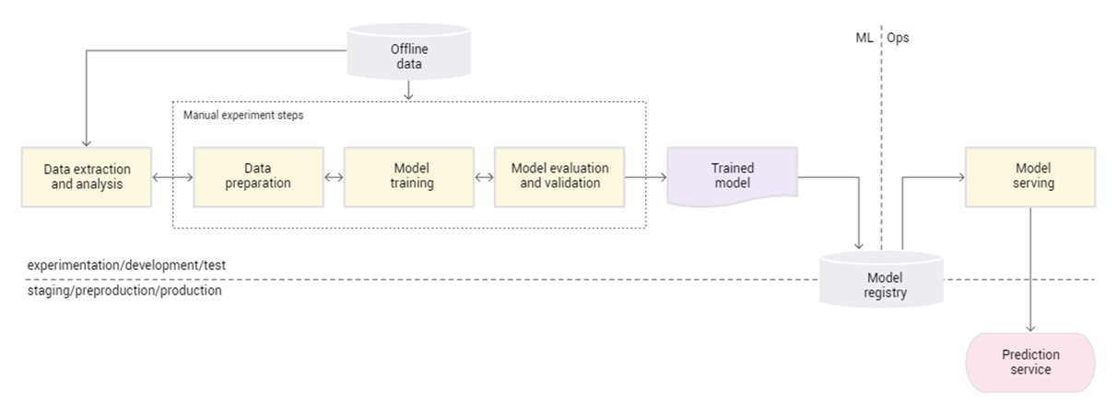
Workflow

Slide 7
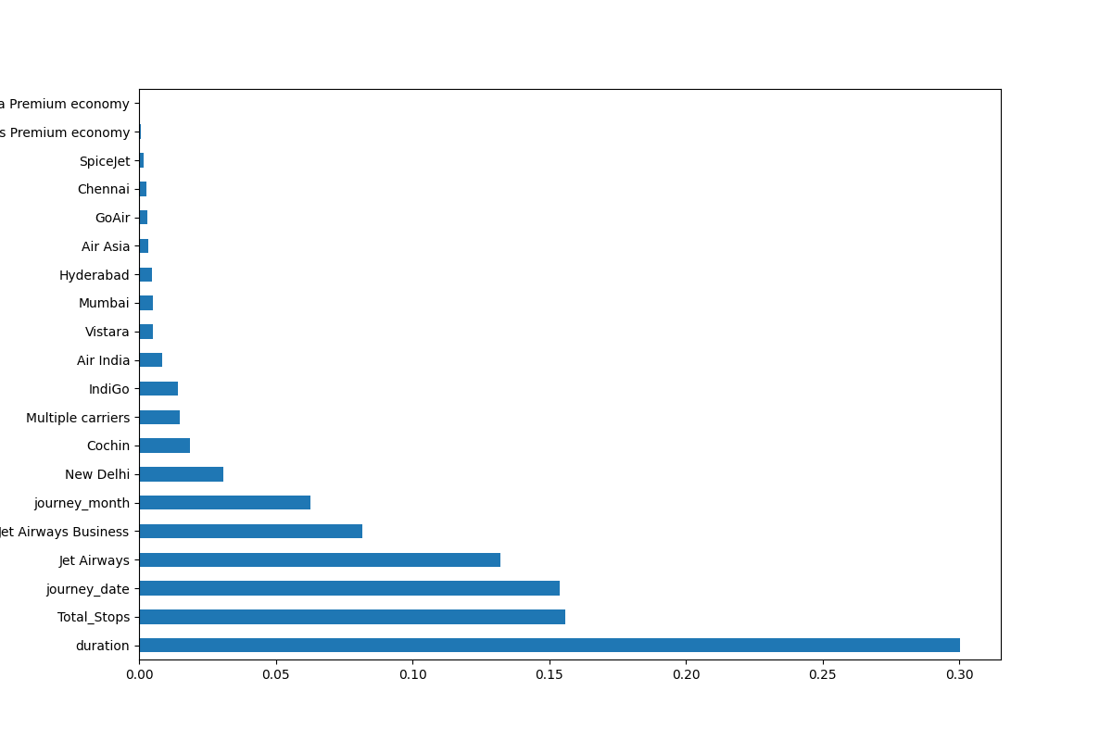
Feature importance

Slide 8
Data Sources:
Data is collected from Kaggle website. Source link:
https://www.kaggle.com/datasets/nikhilmittal/flight-fare-prediction-mh
Technology Stack:
This project involves technology stack that includes Python, Scikit-learn, Streamlit and AWS EC2 instance.
Model Building:
The project employs a Random Forest Regressor model for predicting
fares.

Slide 9
AREAS OF FOCUS
Features
User-Interface
Adding more features such as sign up system, live tracking, flight status, etc.
Recommendations based on partnership with other travelling websites.
Adding graphics.
Adding animations.
More Minimal design

Slide 10
Q&A
Q1: How does the Flight Fare Price Prediction system work?
A: The system collects user input, including departure and arrival locations, travel dates, preferred airlines, the number of stops, and desired travel duration. It uses this data to predict flight fares prices.
Q2: How can users access the system?
A: Users can access the system through a user-friendly front-end interface, either via a web application or a mobile app.
Q3: Are the fare predictions real-time?
A: No, the system does not uses real-time pricing information from airline websites and other sources. It uses historical prices to make estimation and aim to be as accurate as possible

Slide 11
Q&A
Q4: Can users customize their travel preferences?
A: Absolutely. Users can specify their preferred airlines, the number of stops they are willing to accept, and their desired travel duration, allowing for personalized fare prediction.
Q5: How accurate are the fare predictions?
A: The accuracy of fare predictions depends on the data and modeling. The system aims to provide accurate estimates, but actual fares may vary. Our system follows 80% accuracy model.
Q6: Is the system accessible on mobile devices?
A: Yes, the user interface is designed to be responsive and accessible on both desktop and mobile devices.

Slide 12
Q&A
Q7: What was the type of data?
A: The raw data contains numerical and categorical columns. Except target column all other columns were categorical columns which were transformed and encoded to meet the desired results.
Q8: How logs are managed? also include these questions?
A: Logs are manages through Logger.py and logs folder from the project folder. Logs are created for each and every step and stored in logs folder.
Q9: On which cloud platform this project model is deployed?
A:This project is deployed on AWS EC2 instance.

Slide 13
SUMMARY
The Flight Fare Price Prediction project aims to provide traveler with personalized and accurate fare predictions, enabling cost-efficient and data-driven travel planning and improving the overall travel booking experience.

Slide 14
Life is short, and the world is wide.
- An Internet Stranger.

Slide 15
THANK YOU
YASH KESHARI
Md Ehsanul Haque Kanan​

